Slide 1
Hardy-Weinberg Conditions
- random mating
- infinite population size (= no drift)
- no gene flow
- no mutation
- no selection
Genotype frequencies
can be predicted from
allele frequencies
None of the four evolutionary
forces change
allele frequencies

Slide 2
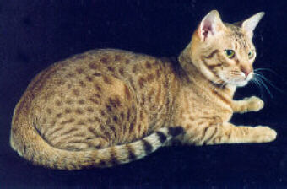
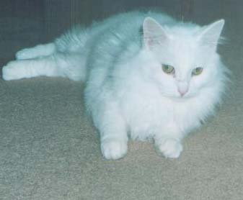
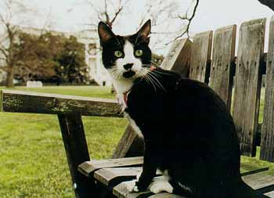
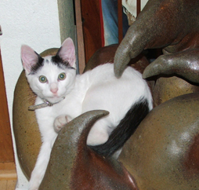
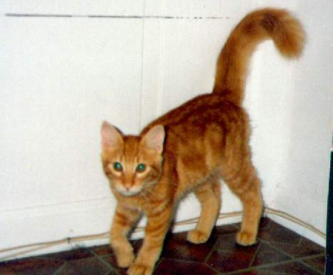
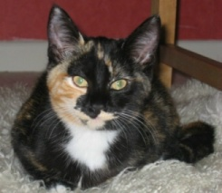
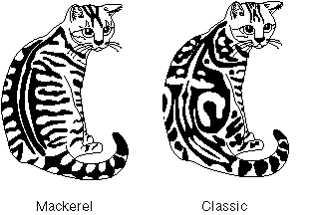
A simple guide to cat coat color genotypes
White spotting
Ss SS
Agouti (A_)
White (W_)
Tabby
A_T_ A_tt
Orange O_ Oo ♀
Notes:
See here for an example: http://jhered.oxfordjournals.org/content/96/5/557.full#sec-1

Slide 3

Yes
W_, STOP
All white?
No
Orange?
Agouti?
ww
Yes
No
O _
Orange with black/tabby?
Yes
A _
Yes
Oo, ♀

Slide 4
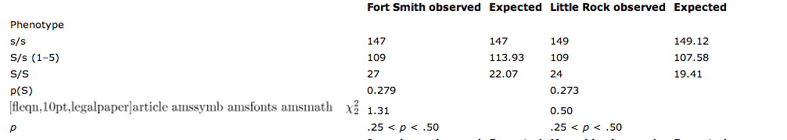
Testing for Hardy-Weinberg
Shostell et al 2005
Notes:
http://jhered.oxfordjournals.org/content/96/5/557.full#T1

